Slide 1

Using Topological Data Analysis to Investigate Galactic Extinction Rates
Dylan Wolf

Slide 2
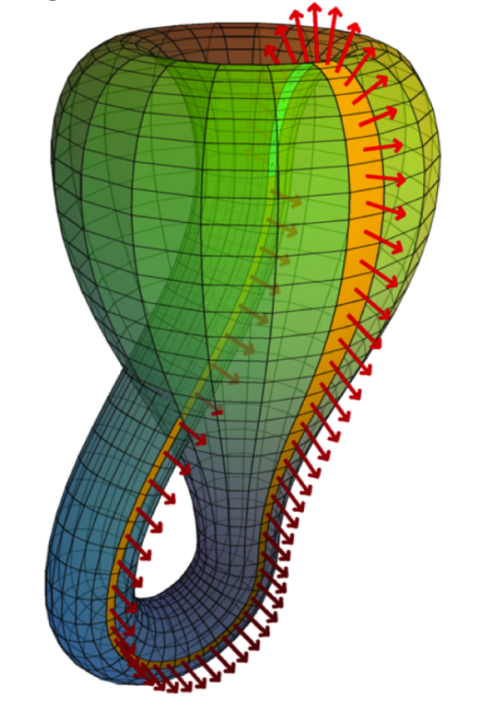
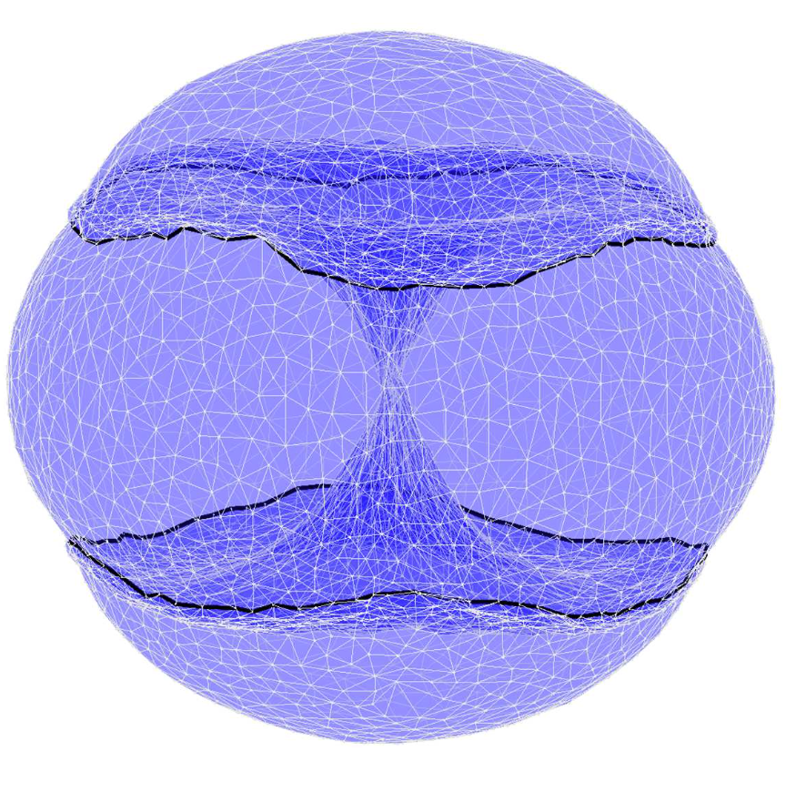

Problem Formulation
Can Topological Data Analysis (TDA) be used to analyze the extinction rates of galactic structures?
1. Topology
2. Topological Data Analysis (TDA)
3. Extinction Rates

Slide 3
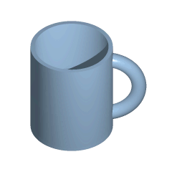
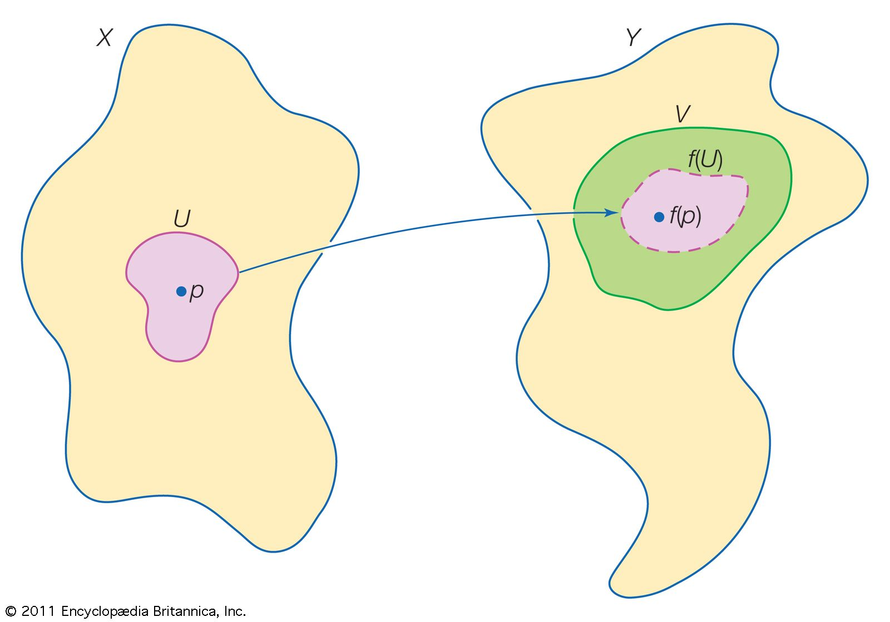
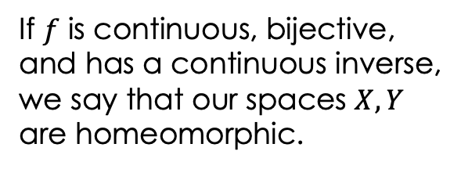

Topology
In topology, we analyze geometric properties of spaces to obtain
structural information. We do this by analyzing epsilon balls:
$$B_{ε}\left(x\right)=\left\{y∈X \right|d\left(x,y\right)<ε\}$$
If $f$ is continuous, bijective,
and has a continuous inverse,
we say that our spaces $X, Y$
are homeomorphic.
Notes:
Topology studies properties of spaces that are invariant under any continuous deformation.

Slide 4
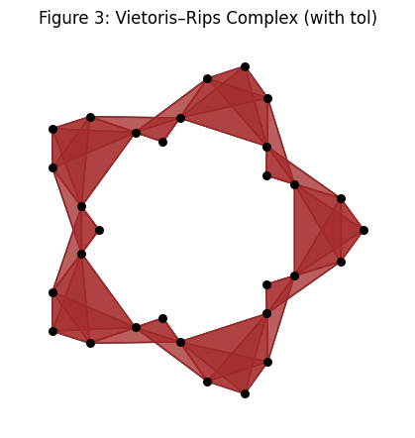
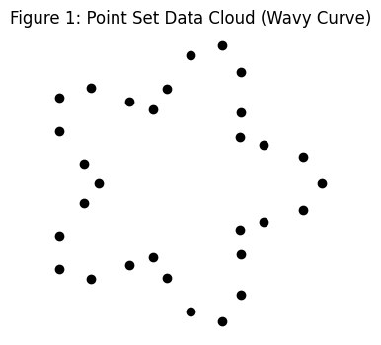
Topological Data Analysis
Persistent Homology tracks how topological features appear and disappear across different scales.
The continuous maps between these evolving geometric structures illustrate the concept of functoriality, the idea that topological invariants should be preserved not just for individual objects but also for the relationships, or maps, between them

Slide 5
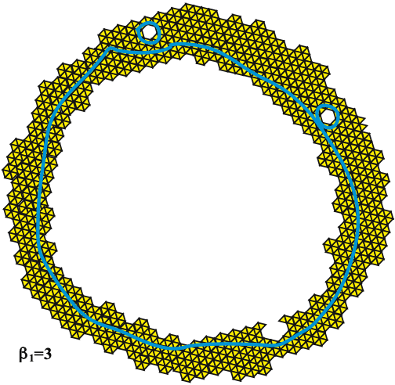
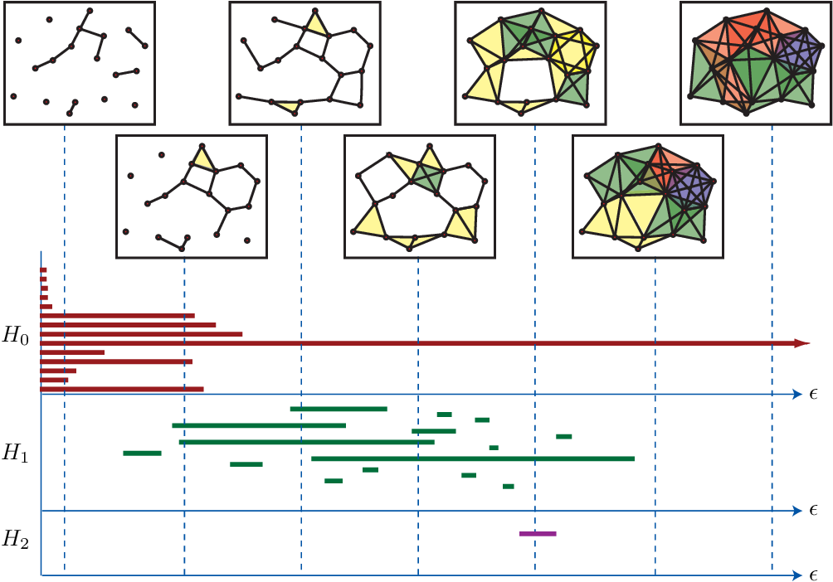
Topological Data Analysis
Betti Numbers: $β_{k}(X, F)$ counts independent $k$-dimensional surfaces in $X$. If two spaces are homotopy equivalent, they have the same Betti numbers.
A 2-Dimensional Object with Three Holes, $β_{1}=3$
Notes:
A homotopy blends two maps into one smooth path between them.
If two spaces can reshape into each other through maps that morph back and forth smoothly, they’re homotopy equivalent.

Slide 6
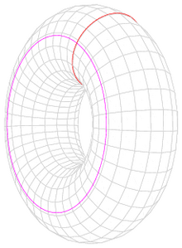

Betti Numbers
$β_{0}$is the number of connected components
$β_{1}$ is the number of one-dimensional or circular holes
$β_{2}$ is the number of two-dimensional voids
So, in our torus, we have $β_{0}=1,{ β}_{1}=2, β_{2}=1.$
If two spaces are homotopy equivalent, they have the same Betti numbers.
Notes:
The kth Betti number refers to the number of k-dimensional holes on a topological surface. A "k-dimensional hole" is a k-dimensional cycle that is not a boundary of a (k+1)-dimensional object.
Betti_1 can be reimagined as a way to cut the torus so that it is no longer connected

Slide 7
Multidimensional Persistence Homology
Multidimensional persistence is an extension of persistent homology in which the birth and death of features are tracked across a multi-dimensional partially ordered set, rather than a single parameter.
In multi-parameter persistence, two or more parameters may be used, such as a distance threshold and a density threshold. Instead of a single chain of spaces, a grid or partially ordered set (poset) of spaces, a multifiltration, is produced. Each node in this grid corresponds to a different combination of parameter values.
The rank invariant act as a robust discrete measure of Betti numbers across such multifiltrations. captures how many homology classes persist throughout a geometric shape in the parameter space.

Slide 8
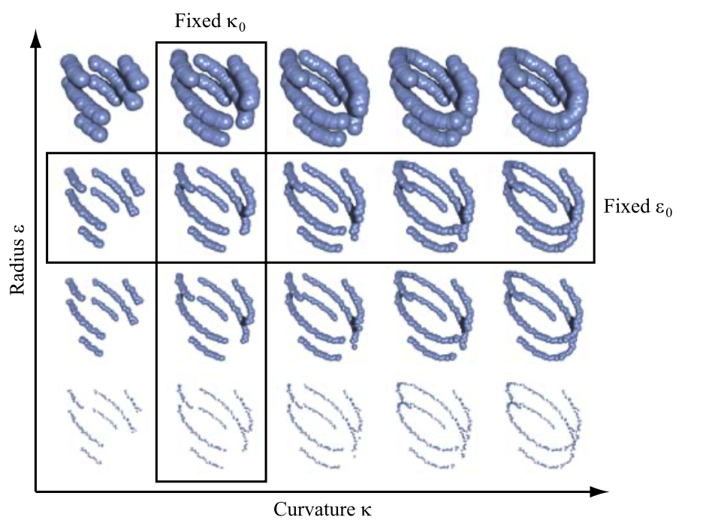
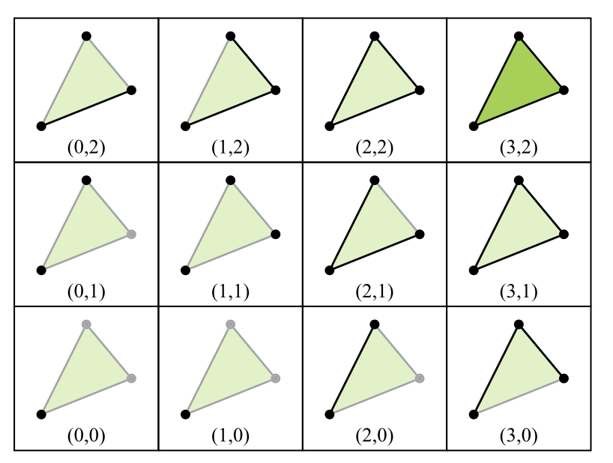
Multidimensional Persistence Homology

Slide 9
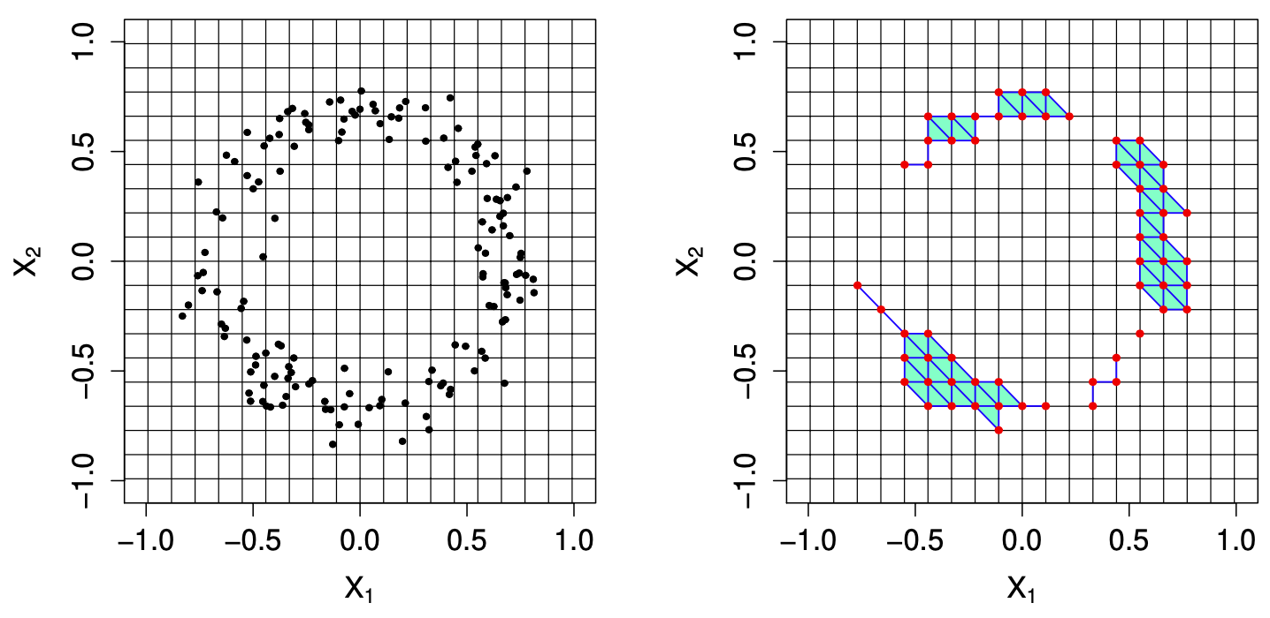
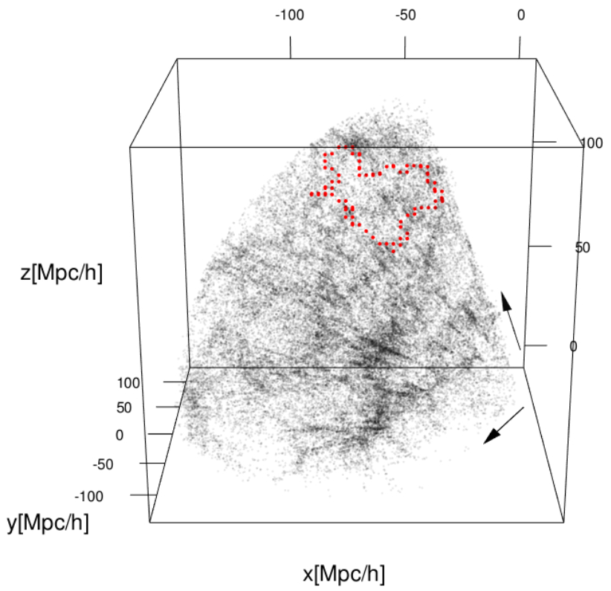
Using TDA to Analyze the Cosmic Web
The red points here represent a filament void.
Notes:
The ability of TDA to identify connected components, loops, and voids has made it an essential tool in astrophysics, where understanding the large-scale structure of the universe requires detecting complex geometric patterns in massive datasets. Just as TDA has been used to extract meaningful features from general point cloud data, it has also been applied to studying the cosmic web, the vast, interconnected network of galaxies, filaments, and voids that define the large-scale matter distribution of the universe.
Specifically, Betti numbers have been used to interpret these structures whereby connected components correspond to galaxy clusters, loops trace closed networks of filaments, and large low-density regions align with cosmic voids.
First, we construct a grid of data points in space then we perform simplicial complexes on these points.

Slide 10
Extinction Rates
Extinction rate is a method of measuring the concentration of interstellar dust. It attenuates and scatters light, altering the perceived brightness and color of celestial objects. This effect, known as extinction, depends on the column density of dust along a given line of sight and can obscure key astrophysical features.
Extinction Rate $≔E\left(B−V\right),$
where $B$ and $V$ are the magnitudes of an astronomical object in the blue and visual filters.

Slide 11
Returning to Problem Formulation
Can Topological Data Analysis (TDA) be used to analyze the extinction rates of galactic structures?

Slide 12
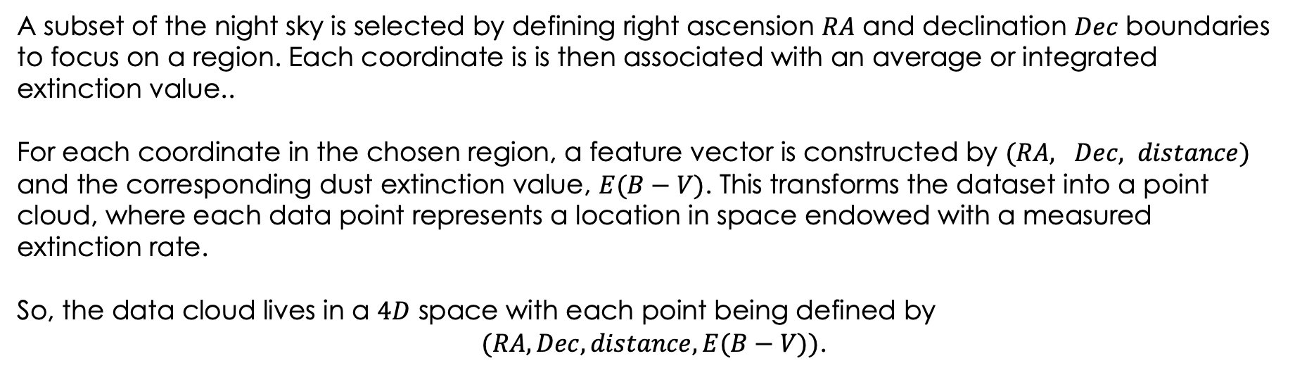
Final Description of the Problem
A subset of the night sky is selected by defining right ascension $RA$ and declination $Dec$ boundaries to focus on a region. Each coordinate is is then associated with an average or integrated extinction value..
For each coordinate in the chosen region, a feature vector is constructed by $(RA, Dec, distance)$ and the corresponding dust extinction value, $E(B−V)$. This transforms the dataset into a point cloud, where each data point represents a location in space endowed with a measured extinction rate.
So, the data cloud lives in a $4D$ space with each point being defined by
$(RA, Dec, distance, E(B−V))$.

Slide 13
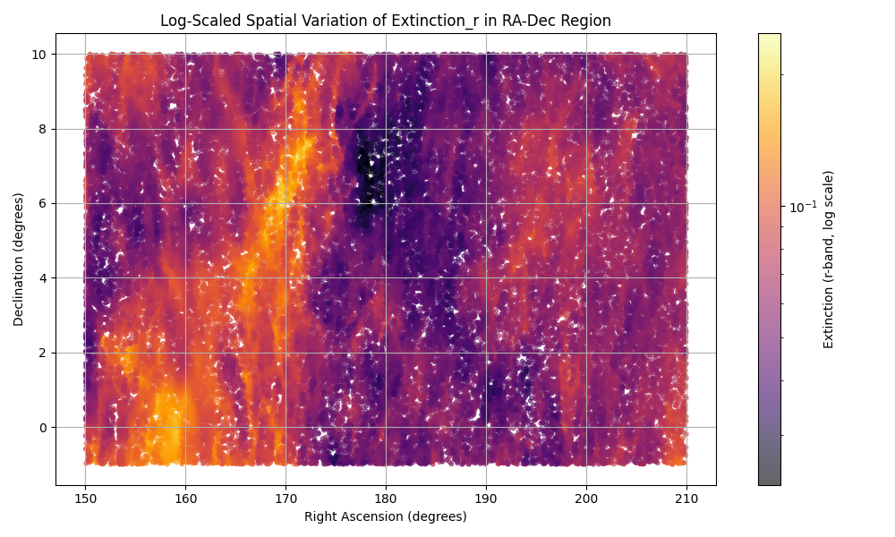
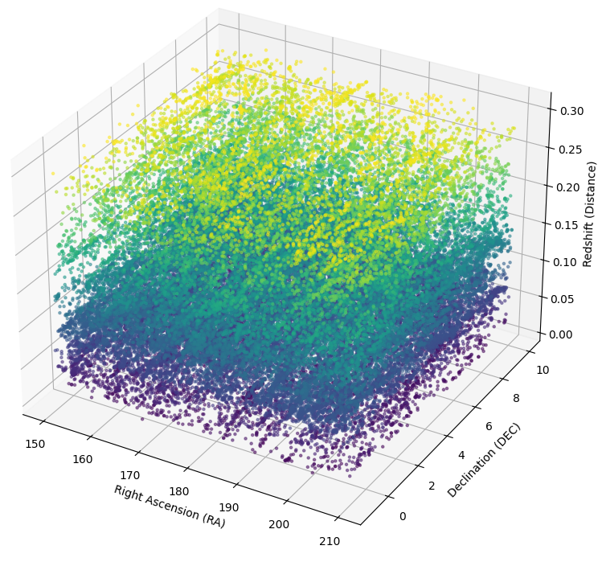
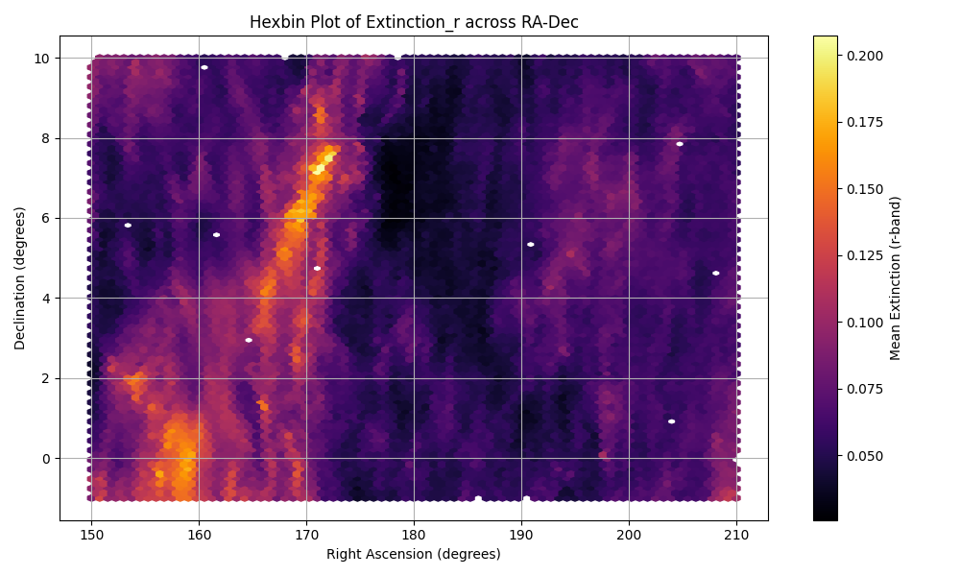
Results: Initial Survey
Notes:
So, I queried public data from SDSS, took 500,000 points, randomly selected 10,000,

Slide 14
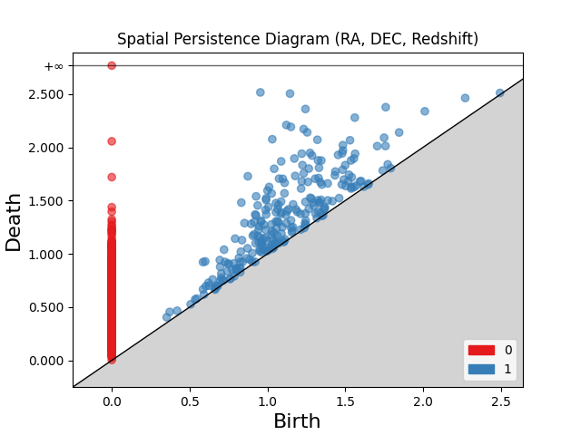
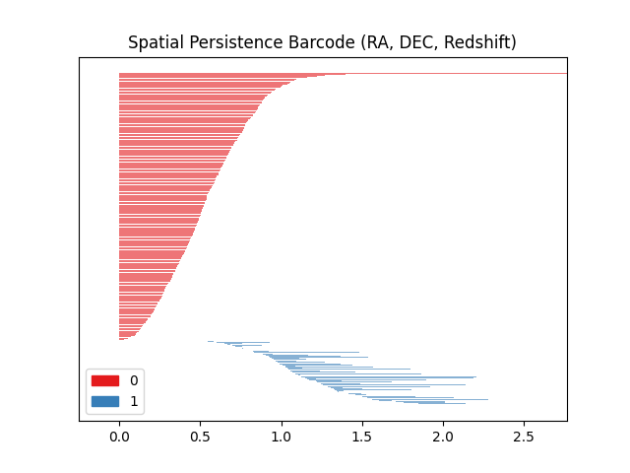
Results: Spatial Persistence Homology

Slide 15
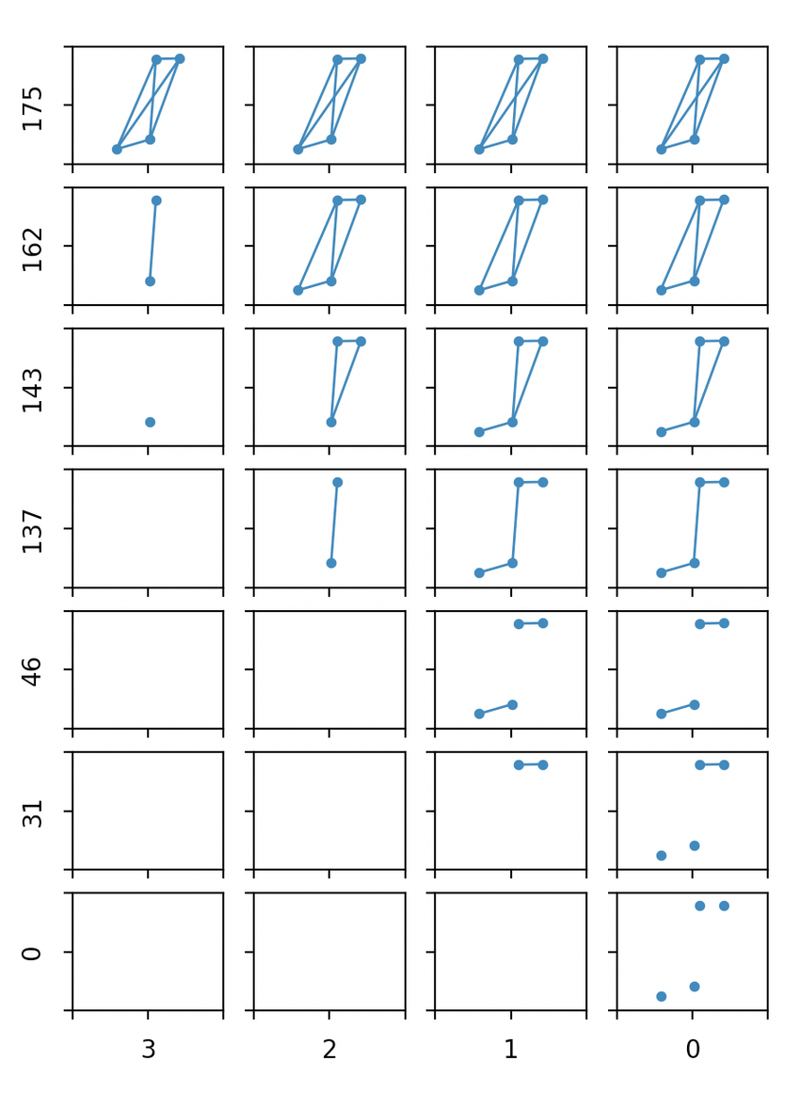



Original Methods

Slide 16
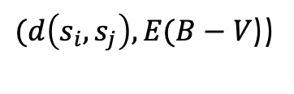
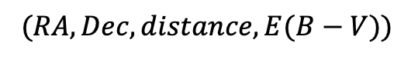
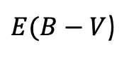

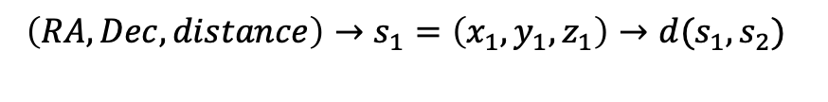
Solution
$\left(RA, Dec, distance\right)→s_{1}=\left(x_{1},y_{1},z_{1}\right)→d(s_{1},s_{2})$
$$s_{2}=\left(x_{2},y_{2},z_{2}\right)→d(s_{2},s_{3})$$
$$…$$
Multidimensional Persistence
Through
Rips Complexes
$(RA, Dec, distance, E(B−V))$
$E(B−V$)
$(d\left(s_{i}, s_{j}\right), E(B−V$))
Notes:
Where s_j is the nearest neighbor to s_i

Slide 17
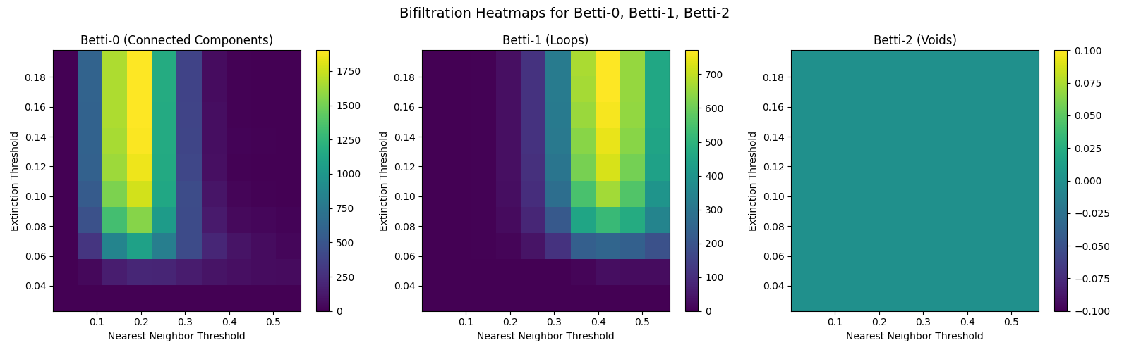
Results
Notes:
The heatmaps for Betti numbers \(\beta_0, \beta_1, \beta_2\) as functions of two parameters: a spatial nearest neighbor threshold and an extinction threshold. These heatmaps offer insight into how extinction structures within the galactic dataset vary spatially.
For \(\beta_0\), the heatmap shows a rapid decrease as the nearest neighbor threshold increases. As the spatial scale broadens, there is a sharp decline in the number of connected components, indicating that these extinction-rich regions merge quickly into fewer larger clusters. This result strongly suggests a high degree of spatial clustering in extinction values, pointing to regions in the dataset where points with comparable extinction measurements are closely grouped.
Examining the \(\beta_1\) heatmap, which quantifies the loops or cycles within the dataset, distinct patterns emerge at intermediate scales of spatial proximity and extinction thresholds. These loops likely correspond to ring-like or cyclical patterns within the spatial distribution of extinction. The presence of such features implies that the cosmic dust distributions do not merely cluster but also exhibit more intricate geometric arrangements, possibly resembling structures such as filaments or ring-shaped plumes commonly observed in astrophysical contexts.
Collectively, these results highlight significant spatial dependence and complexity in galactic extinction distributions. The patterns observed—particularly the pronounced clustering, \(\beta_0\), and loop structures, \(\beta_1\),—indicate that extinction rates are spatially structured in a manner consistent with astrophysical processes that give rise to complex spatial arrangements. However, the lack of detectable void structures, \(\beta_2\), further underscores that extinction is distributed continuously rather than forming isolated pockets devoid of cosmic dust.

Slide 18
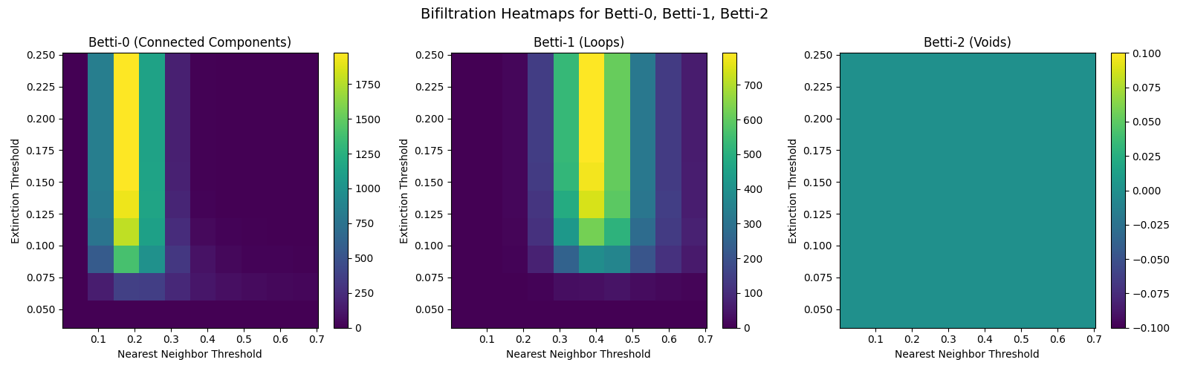
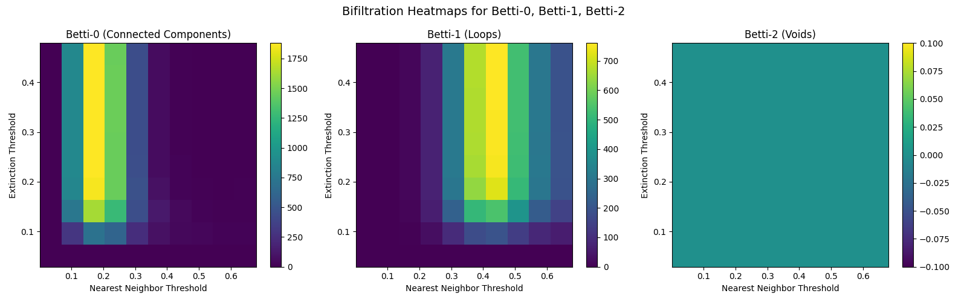
Additional Sky Regions

Slide 19

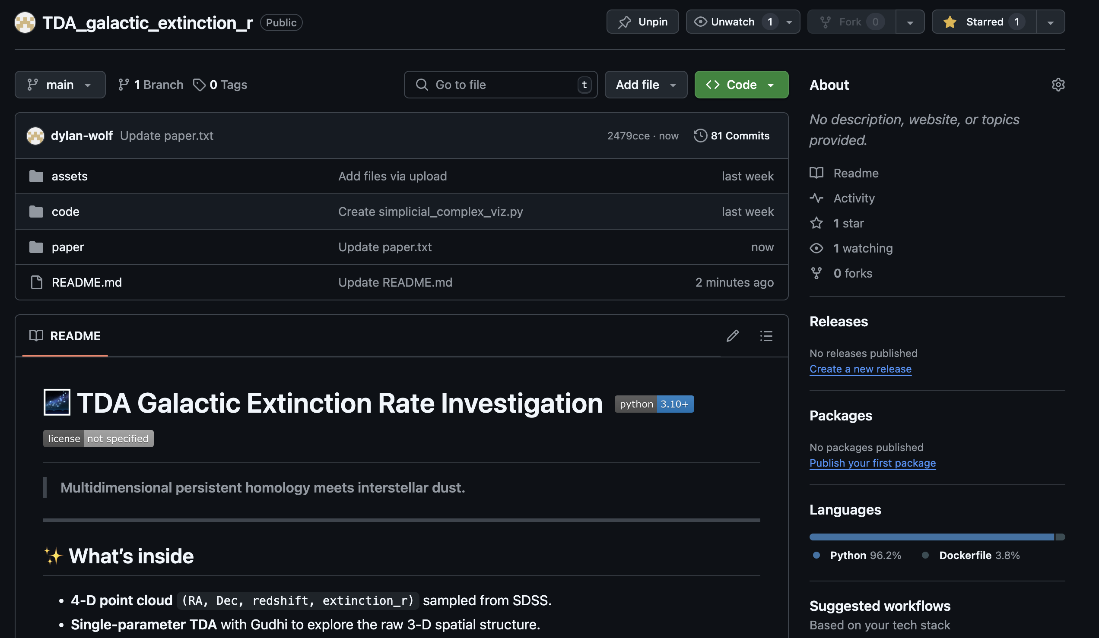

Slide 20
Conclusion
• Demonstrated that a multidimensional persistence homology workflow can be applied to
galactic extinction data
• Resulting visualizations are consistent with known dust structures
• Current analysis is exploratory and not yet sufficient for astrophysical claims
• Main contribution is methodological—shows where TDA fits into astronomical workflows

Slide 21
Future Directions
Continue to expand to different regions of the sky
Extend analysis to multiple sky fields to test if loop patterns are local artifacts
or galaxy-wide features
Compare topological summaries with 3D dust reconstructions for physical validation
Experiment with alternative metrics
Vary distance metrics and refine spatial parameters
Vary radius thresholds to observe how large- and small-scale structures emerge
Integrate additional observational parameters and expand into higher-dimensional analysis

